Slide 1
Regularization and Cross Validation
Instructor: Mohammad Hasan
Office: 13-240
09/16/26
Notes:
Welcome and Introductions

Slide 2
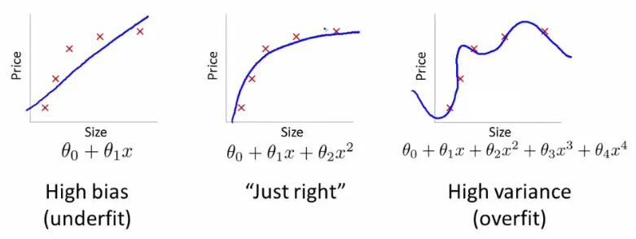
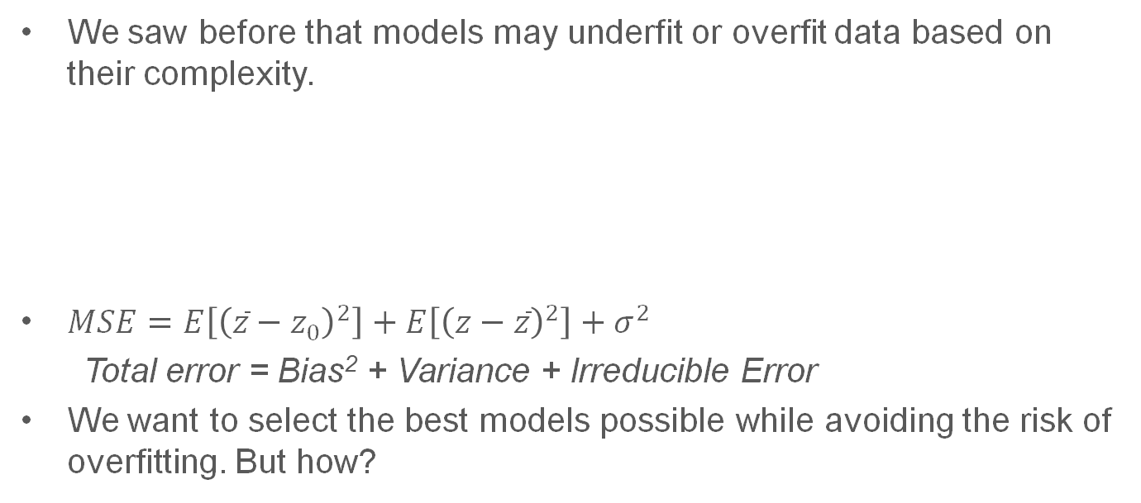
Motivation
We saw before that models may underfit or overfit data based on their complexity.
$MSE=E\left[{\left(\overline{z}−z_{0}\right)}^{2}\right]+E\left[{\left(z−\overline{z}\right)}^{2}\right]+σ^{2}$
Total error = Bias² + Variance + Irreducible Error
We want to select the best models possible while avoiding the risk of overfitting. But how?

Slide 3
Unknown Model
Suppose that data is provided to you but you are completely unable to know what its model looks like ...
We might want to start with some universal approximators (polynomials, sinusoidal functions for periodic behaviors, etc)
We want our model to retain as much complexity as needed while minimizing overfitting!
We also want to detect overfitting and compare models.

Slide 4
Overview
Regularization Methods (LASSO, Ridge, Elastic Net)
Validation Methods (k-fold cross validation)

Slide 5














Regularization

Slide 6
















Regularization

Slide 7
Validation and Model Selection
We want to be able to judge models against each other without seeing the testing data.
It’s convenient to get an estimate of the generalization ability of models before using testing data.
Testing data may be completely invisible to us in practice (not yet acquired, data from Kaggle competitions).

Slide 8
Hold-out Validation Set
Training set
Training Data
We best model is found, all training data is used to train your model
Validation set
(test your model here. Not used for model comparison)
Full data X
Full data Y
Testing Data

Slide 9
K-Fold Cross Validation
Training Data
Each fold is used as a validation set (pseudo-test set) once.
Model is trained on the other folds.
Break into equal “folds”
Full data X
Full data Y
Testing Data

Slide 10
References
Data-Driven Science and Engineering: Machine Learning, Dynamical Systems and Control, Brunton & Kutz, second edition. Section 4.6
Materials from this slides (slide 6 – 10) used Machine Learning, A First Course for Engineers and Scientists by Lindholm et. al (March 4th, 2026 version), section 4.4 as a reference. Access to this document is free at the publishers’ GitHub page.

Slide 11
Extra notes

